Slide 1
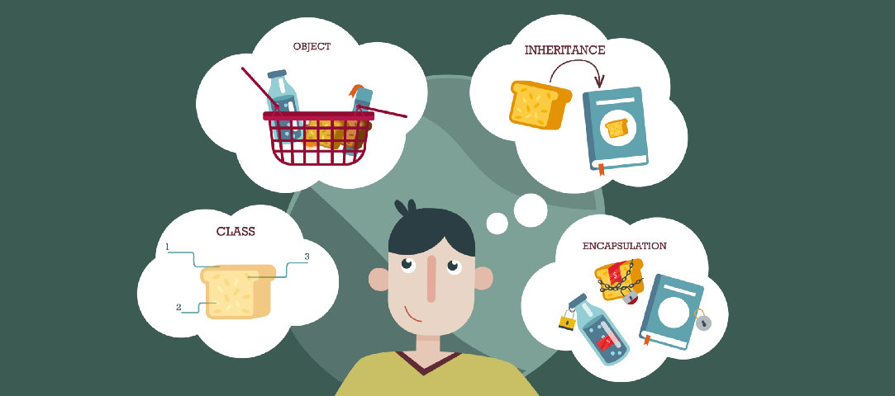
Lecture – 10 Abstraction in Java : Abstract Class and Interface
Afsara Tasneem Misha
Lecturer
Department of CSE
Daffodil International University

Slide 2
Contents
1. Abstraction in Java
2. Ways to achieve Abstraction
2.1. Abstract Classes and Abstract Methods
2.2. Interface
3. Advantage of Abstraction
4. Useful Links

Slide 3
Topic - 1 : Abstraction in Java

Slide 4
Topic - 1 : Abstraction
Abstraction is a process of hiding the implementation details and showing only functionality to the user.
Another way, it shows only essential things to the user and hides the internal details, for example, sending SMS where you type the text and send the message. You don't know the internal processing about the message delivery.
An Abstraction is a process of exposing all the necessary details and hiding the rest. In Java, Data Abstraction is defined as the process of reducing the object to its essence so that only the necessary characteristics are exposed to the users.

Slide 5
Topic - 2 : Ways to achieve Abstraction

Slide 6
Topic - 2 : Ways to achieve Abstraction
There are two ways to achieve abstraction in java
1. Abstract class (0 to 100%)
Interface (100%)
In Java, we can achieve Data Abstraction using Abstract classes and interfaces.
Interfaces allow 100% abstraction (complete abstraction). Interfaces allow you to abstract the implementation completely.
Abstract classes allow 0 to 100% abstraction (partial to complete abstraction) because abstract classes can contain concrete methods that have the implementation which results in a partial abstraction.

Slide 7
Topic – 2.1 : Abstract Class in Java

Slide 8
2.1: Abstract Class
A class which is declared as abstract is known as an abstract class.
An Abstract class is created through the use of the abstract keyword.
It is used to represent a concept.
Object Can not be created of an Abstract Class.
Does not Support multiple inheritance.

Slide 9
Points to Remember
An abstract class must be declared with an abstract keyword.
It can have abstract and non-abstract methods.
The class has to be declared as abstract if it contains at least one abstract method.
It can have constructors, static methods and final methods.
It can have any type of variables (Static, non-static, final, non-final etc)

Slide 10
Syntax of declaring an abstract class:
To declare an abstract class we use the keyword abstract. The syntax is given below:
access-specifier abstract class ClassName
{
//class body
}

Slide 11
Abstract Methods in Java
A method which is declared as abstract and does not have implementation is known as an abstract method.
The declaration of an abstract method must end with a semicolon ;
The child classes which inherit the abstract class must provide the implementation of these inherited abstract methods.
Syntax of declaring abstract methods:
access-specifier abstract return-type method_name();
Example:
public abstract void printStatus();

Slide 12
Example – 1
An abstract class that has abstract method
public abstract class Vehicle {
public abstract void move();
}
public class Car extends Vehicle {
public void move()
{
System.out.println("Car moves faster.");
}
public static void main(String[] args) {
Car c1 = new Car();
c1.move();
}
}
// Outputs
Car moves faster.

Slide 13
Example – 2
An abstract class that has abstract and non-abstract methods
public abstract class Vehicle {
public abstract void move();
public void carry()
{
System.out.println("All Vehicle carry loads");
}
}
public class Car extends Vehicle {
public void move()
{
System.out.println("Car moves faster.");
}
public static void main(String[] args) {
Car c1 = new Car();
c1.move();
c1.carry();
}
}
// Outputs:
Car moves faster.
All Vehicle carry loads

Slide 14
Example – 3
An abstract class that has abstract , non-abstract methods and Constructor
public abstract class Vehicle {
public Vehicle()
{
System.out.println("Vehicle is Created.");
}
public abstract void move();
public void carry()
{
System.out.println("All Vehicle carry loads");
}
}
public class Car extends Vehicle {
public void move()
{
System.out.println("Car moves faster.");
}
public static void main(String[] args) {
Car c1 = new Car();
c1.move();
c1.carry();
}
}
// Outputs:
Vehicle is Created.
Car moves faster.
All Vehicle carry loads

Slide 15
UML representation
Vehicle
+ Vehicle() + move() : void + carry () : void
Italic font
Italic font
extends
Car
+ move() : void + main(String[]):void

Slide 16
Example – 4 : Home Work
Vehicle
+ Vehicle() + move() : void + carry () : void
Car
+ move() : void + main(String[]): void
Boat
+ move() : void + main(String[]): void

Slide 17
Example – 5 :
Home Work
Animal
+ eat() : void + move() : void + life() : void
Human
+ eat() : void + move() : void + talk () : void
Lion
+ eat() : void + move() : void + hunt () : void
Bird
+ eat() : void + move() : void + fly () : void
Main
+main(String [] ) : void

Slide 18
Topic – 2.2 : Interface in Java

Slide 19
2.2: Interface in Java
An interface is a blueprint or template of a class.
It is much similar to the class but the only difference is that it has abstract methods and static constants.
Object can not be created of an interface.
All the methods in an interface are by default abstract.
All variables are declared as both static and final.
An interface does not contain any constructors.
An interface can not be extended or inherited by a class; it is implemented by a class.
Multiple-Inheritance supported.

Slide 20
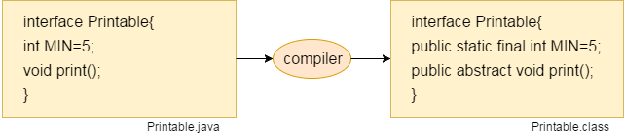
Internal addition by the compiler

Slide 21
Syntax of declaring an Interface
interface <interface_name>{
// declare constant fields
// declare methods that abstract
//by default.
}

Slide 22
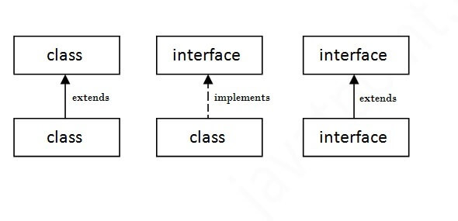
The relationship between classes and interfaces
As shown in the figure given below, a class extends another class, an interface extends another interface, but a class implements an interface

Slide 23
Example – 6
public interface Drawing {
public void draw();
}
public class Line implements Drawing {
public void draw()
{
System.out.println("I am drawing a Line");
}
public static void main(String[] args) {
Line l = new Line();
l.draw();
}
}
// Outputs
I am drawing a Line

Slide 24
UML representation
<<Drawing>>
+ draw() : void
implements
Line
+ draw() : void + main(String[]):void

Slide 25
UML representation
<<Drawing>>
+ draw() : void
implements
Line
+ draw() : void
Circle
+ draw() : void
Main
+ main(String[]):void

Slide 26
Example – 7: Find out the output and draw the UML
interface Bank{
double account();
}
class TestInterface{
public static void main(String[] args){
SIBL b=new SIBL();
b. account ();
DBBL d=new DBBL();
d. account ();
}
}
public class SIBL implements Bank{
public double account ()
{
System.out.println("Account System in SIBL”);
}
}
public class DBBL implements Bank{
public double account ()
{
System.out.println("Account System in DBBL”);
}
}
// Outputs
??????

Slide 27
Example – 8 : Home Work
<<Player>>
+ play() : void + stop() : void + pause() : void + reverse() : void
implements
CDPlayer
+ audio() : void
DVDPlayer
+ video() : void

Slide 28
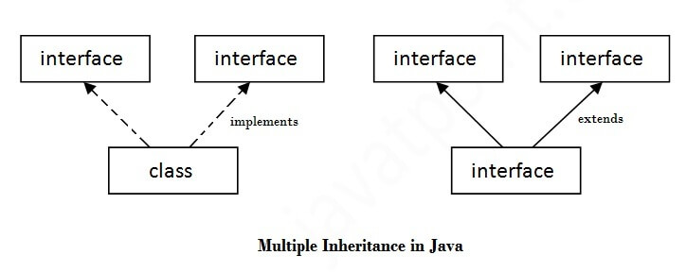
Multiple inheritance in Java by interface
If a class implements multiple interfaces, or an interface extends multiple interfaces, it is known as multiple inheritance

Slide 29
Example – 9
class DemoClass implements FirstInterface, SecondInterface {
public void myMethod() {
System.out.println("Some text..");
}
public void myOtherMethod() {
System.out.println("Some other text...");
}
}
interface FirstInterface {
public void myMethod();
}
interface SecondInterface {
public void myOtherMethod();
}
class MyMainClass {
public static void main(String[] args) {
DemoClass myObj = new DemoClass();
myObj.myMethod();
myObj.myOtherMethod();
}
}

Slide 30
Some helpful Links
https://techvidvan.com/tutorials/abstraction-in-java/
https://www.javatpoint.com/abstract-class-in-java
https://techvidvan.com/tutorials/java-interface/

Slide 31

Thank you!

